Slide 1
Virtualizing Lifemapper for PRAGMA: Step 2 - The Computational Tier
By
Aimee Stewart, Cindy Zheng,
Phil Papadopoulos, C.J. Grady
University of Kansas Biodiversity Institute
University of California, San Diego
http://www.lifemapper.org
Notes:
Introductions
I’m here to tell you about this second step in the Virtual Biodiversity Expedition that was envisioned at PRAGMA 22 a year ago in Melbourne.
We demonstrated the first step of that expedition at the last PRAGMA, in Seoul,
It involved running PRAGMA data through Lifemapper computations and cataloging outputs in a PRAGMA Geoportal catalog.
Umashanthi Pavalanathan and Beth Plale at Indiana University led that first step and Reed Beaman at the University of Florida provided, and maintains the data for this expedition

Slide 2

Lifemapper
Data
Climate Data
Species Archive
Input: points
Output: potential habitat maps
Tools
LmSDM: Species Distribution Modeling
LmRAD: Range and Diversity
GBIF
Notes:
First, I’d like to give you a brief background on what Lifemapper is
Lifemapper is a software project at the University of Kansas Biodiversity Institute.
It has 2 core functions: Providing data and research tools through web services.
The data consists of
climate data plus
globally distributed species occurrence data, aggregated by the Global Biodiversity Information Facility (GBIF)
From these data Lifemapper calculates potential species distribution maps.
All of these input and output data can be downloaded using web services or viewed on our website
They are also easily accessed programmatically
The research tools include two modules,
Species Distribution Modeling, or LmSDM, for mapping the potential distribution of individual species and
Range and Diversity, or LmRAD, for looking at landscape level ecology with multiple species.
All of the tools in these modules are available through web services and we provide easier access through a
python client for programmers and
Through plug-ins to the open source applications VisTrails (for workflows) and Quantum GIS (for mapping and GIS)

Slide 3




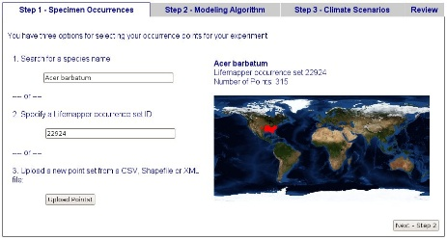

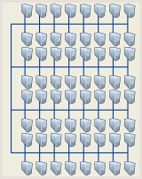
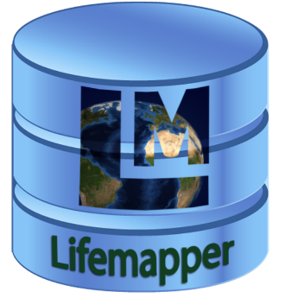
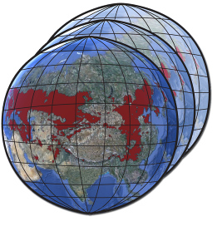
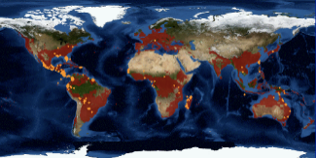
Lifemapper Tiers
Compute Tier
Management Tier
Data Tier
Web Tier
Client Tier
Species Distribution Modeling
Range and Diversity
Analysis
Pipeline
Lm Web site
REST Web Services
Desktop client
Browser client
Species
Sensors
Models
Data updater
Job generator
Job tracker
Metadata manager
Job submission
Data request
Result request
Experiment management,
Result visualization, exploration, analysis
Virtual clusters request Jobs
Result archives
Notes:
Another relevant piece of information here is how Lifemapper is designed.
LM is a multi-tier system; each tier is designed to communicate with the others, but work independently.
The goal is to have multiple instances of one or more tiers running for individual projects, groups, or anyone else who has a need or finds it convenient to maintain a local piece of the Lifemapper puzzle.
This is also to allow Lifemapper to scale for greater computational and data storage needs.
And it will allow those with data access restrictions to control where their data is deployed.
It also provides a backup or failsafe in case any tier needs maintenance or fails
The tiers include …
The Data Tier, which stores all archive input and ouputs, as well as user inputs and outputs.
The Management Tier
creates jobs for analysis requests by users or the archive and
tracks the status and all parameters of experiments.
The Compute Tier
requests jobs from Management and returns them when they are complete.
Compute resources may be optimized for particular data inputs, user jobs, or types of calculations.
The Web Tier makes all data and metadata in the Data Tier and research tools in the Management Tier available through web services.
The Client Tier includes the
website and
a python application for programmatic access through user scripts or QGIS and VisTrails applications.

Slide 4



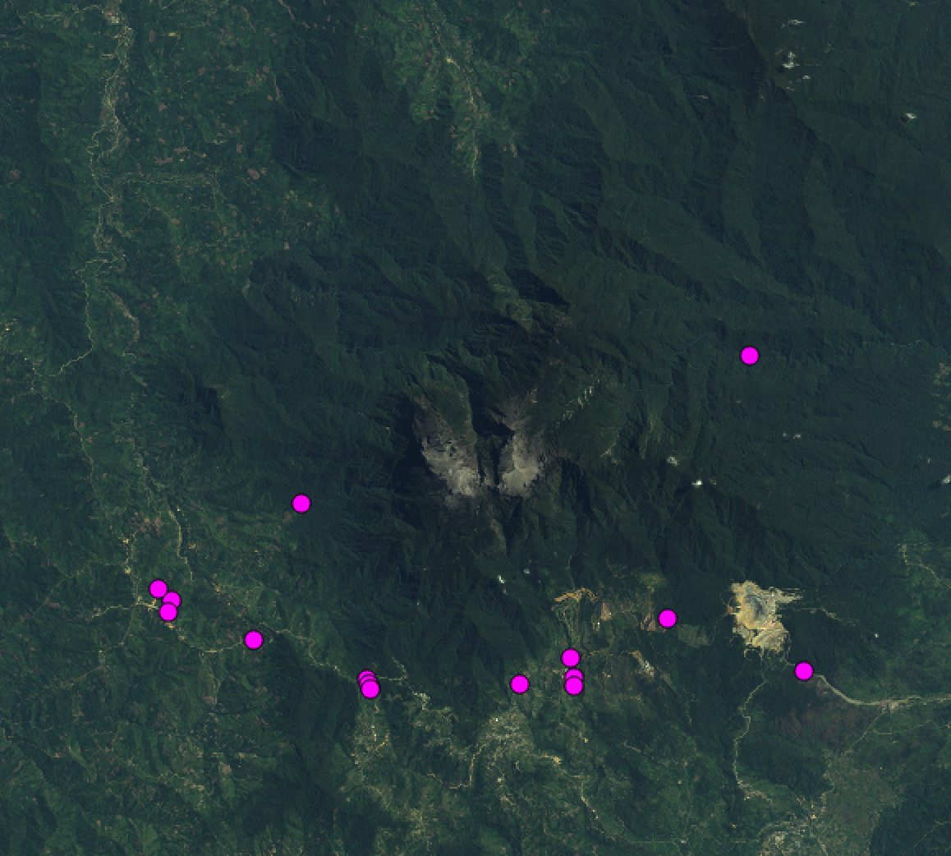

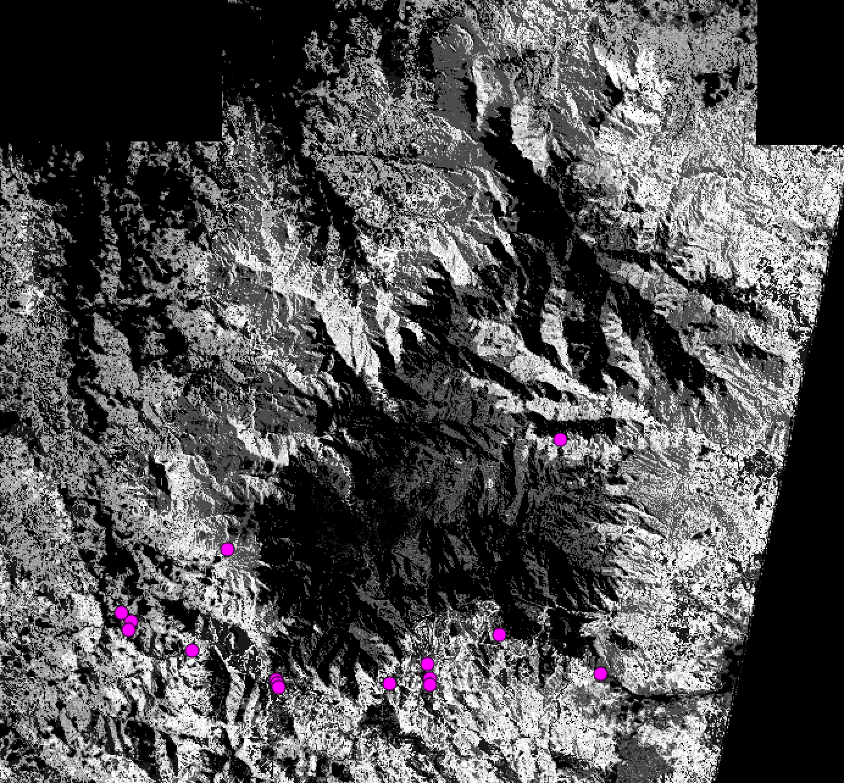
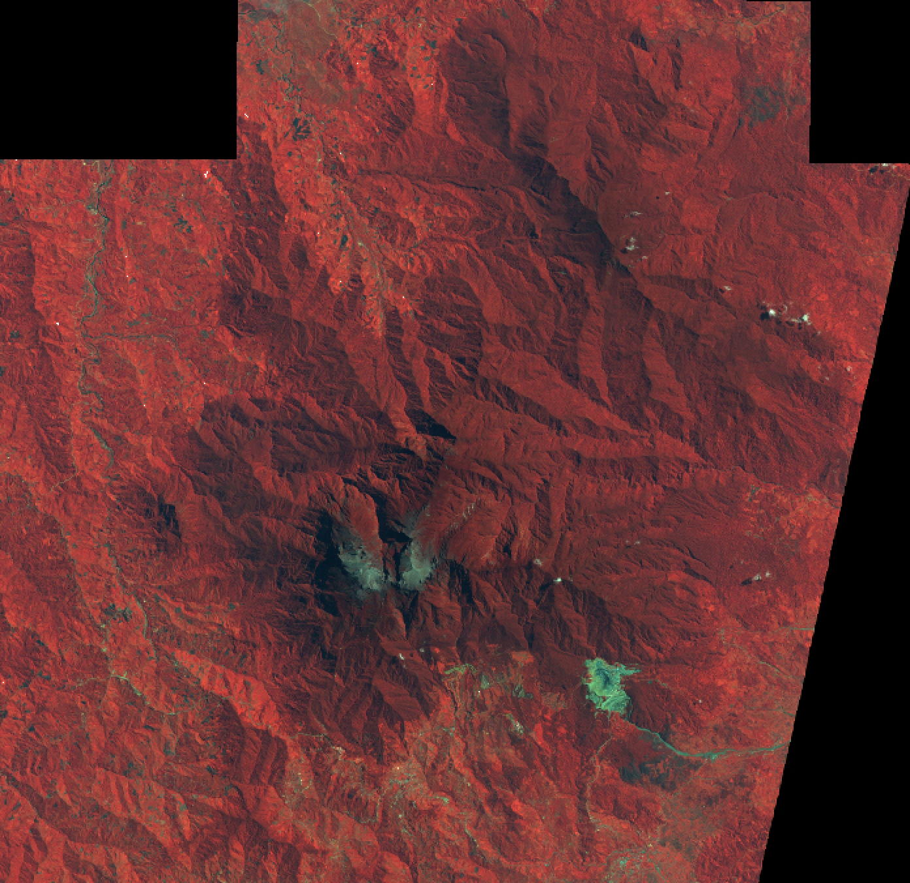
Virtual Biodiversity Expedition Step 1: Species Distribution Modeling
1
2
5
3
Species Occurrence Data
4
3
Potential Habitat
Landsat Data
Notes:
PRAGMA Virtual Biodiversity Expedition,
At its core, Step 1 was a simple Species Distribution Modeling experiment, but with inputs coming from and outputs going to different PRAGMA institutions, and calculations being performed, at the Biodiversity Institute’s Lifemapper project, on the compute cluster located there.
We started with satellite and species data from Mount Kinabalu in Sabah, Malaysia.
Umashanthi cataloged the expedition metadata at the Universiti Teknologi Malaysia (UTM) GeoPortal instance data,
then implemented a process that analyzed expedition metadata to initiate Lifemapper experiments,
then, after the LM experiments were complete, retrieved and cataloged metadata in a GeoPortal instance running at IU.
So essentially, step 1 was assembling the experiment from metadata in cataloged in a PRAGMA geoportal, data in Dropbox, running the experiment at the (only) Lifemapper compute resource in Kansas and cataloging the metadata for results in another PRAGMA geoportal.

Slide 5



Adding a PRAGMA Compute Tier
LM Management
LM Compute
LM Compute
LM Data
Notes:
At the last PRAGMA, we planned Step 2, which boils down to creating another Lifemapper Compute resource that is a PRAGMA resource.
This new Compute resource is a virtual cluster at SDSC
There are 3 advantages of this –
first, it demonstrates the portability of the computations, allowing certain process requests to be sent to compute services that excel at them, and
second, creates redundancy for computations – if our cluster goes down, we still have the SDSC Virtual Cluster to run jobs.
third, to minimize input data replication.
For example, the high-resolution climate and elevation data that Lifemapper provides for user SDM jobs totals about 300 GB.
In theory, every job has unique requirements, and LM management would send the data for each job individually.
In practice, that means the compute nodes request the same data repeatedly.
So, we set up a system to move the data once, and park it there.
We had a system for handling data among our cluster nodes, but it was specific to our setup.
When we went from our own little playground, to another one, we added a lightweight database to catalog input layers, so that it only requests them the first time

Slide 6
DEMO
Notes:
QGIS – new experiment
Use

Slide 7
Preparation
Compute Tier
Management Tier
Data Tier
Web Tier
Client Tier
Species Distribution Modeling
Range and Diversity
Analysis
Pipeline
Lm Web site
REST Web Services
Desktop client
Browser client
Species
Sensors
Models
Data updater
Job generator
Job tracker
Metadata manager
Job submission
Data request
Result request
Experiment management,
Result visualization, exploration, analysis
Virtual clusters request Jobs
Result archives
Notes:
LM Preparation – We generalized to prepare for deploying another Compute Tier by de-coupling the Management and Compute tiers
with more than one compute resource, we changed communication direction so Compute Tiers pull jobs instead of the Management Tier pushing jobs.
This way, management doesn’t have to handle restrictions or requirements of each Compute resource, they each pull jobs they are equipped to deal with.
SDSC - SDSC Preparation – Phil and Cindy – building a custom cluster image

Slide 8
Execution
Specialization
Resources request subset of available jobs
Based on data, users, computation type
Scaling
Management - Increased job speed
Compute – increased data replication
Notes:
Execution – Specialization and Scaling
We found that in some cases we wanted increased Specialization.
For example, with 2 Compute Tiers pulling jobs, it made sense to have each handle different types based on its resources.
So now, each compute resource is configured to request only a subset of available jobs, based on computation type, user, data, etc –
Our local cluster computes the high-resolution user jobs, so that the 300 gb of input data doesn’t have to be replicated everywhere.
The SDSC cluster computes all PRAGMA jobs, so the input satellite data stays there.
We have found that new constraints and dependencies arise with every enhancement or generalization.
In particular, our increased capacity didn’t Scale
The Management Tier didn’t immediately handle the increased job speed –
We tuned Postgres to handle more requests and changed to connection pooling so we could reserve connections for the website and data pipeline
The Compute Tier couldn’t handle increased data replication –
the input data is retrieved when a job is requested. Jobs weren’t waiting long enough for the initial Layer retrieval, and were timing out before they got all their inputs.
For the time being, they are just returned with a ‘Recoverable Error’ status and re-submitted.
SDSC
Installation – python versions – make sure compilation is with newest version
Dependencies: OM documentation had older versions of geospatial software, we use later versions with different dependencies
Testing – LM corrected
Disk space: some on shared space, some on each node

Slide 9

Lifemapper funded by:
U.S. National Science Foundation NSF EPSCoR 0553722
NSF EPSCoR 0919443
EHR/DRL 0918590
BIO/DBI 0851290
OCI/CI-TEAM 0753336
http://www.lifemapper.org
astewart@ku.edu
Notes:
This work was funded by the National Science Foundation and

